Slide 1

Power Bi Project
on
Customer Churn Analysis
A Data-Driven Approach to Understanding Customer Behavior & Retention
Presented by : Udvisha Kosti
Batch no : 456
INNOMATICS RESEARCH LABS
DISUKHNAGAR BRANCH

Slide 2
Business Problem :
Telecom companies face high customer churn, leading to significant revenue loss. company lacks visibility into key churn drivers such as contract type, service usage patterns, customer demographics, and service add-ons, making it difficult to take preventive actions and retain high-value customers.
Objective:
To develop an interactive Power BI analytics solution that:
Identifies customer churn patterns
Analyzes demographic, service-level, and billing-based factors
Measures churn rate, revenue impact, and risk distribution
Highlights high-risk segments
Supports data-driven decisions to reduce churn and improve customer retention

Slide 3
Data set description
Data Source: Telco Customer Churn Dataset
Total Columns: 22
Key Data Fields:
Customer Profile: gender, Senior Citizen, Partner, Dependents
Services: Phone Service, Internet Service, Streaming TV, Tech Support
Billing: Monthly Charges, Total Charges, Payment Method, Paperless Billing
Customer Lifecycle: tenure, Contract
Target Variable: Churn (Yes/No)

Slide 4
Data Cleaning :
Performed in Power Query:
Handled data types
Created Tenure Buckets
Removed nulls
Converted required bool fields to Yes/No

Slide 5
Measures and DAX :
Total Customers
Churned Customers
Churned Count
Churn Rate %
Average Monthly Charges
Average Tenure
Average Total Charges

Slide 6
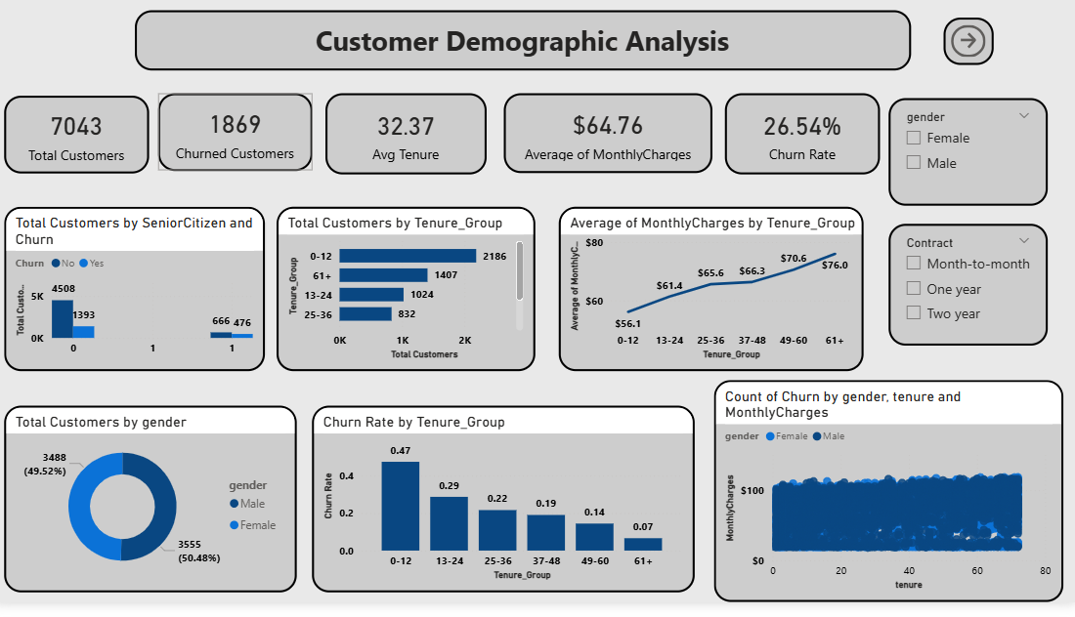

Slide 7
Key Questions Answered
What is the gender distribution?
How many senior citizens churned?
How are customers segmented by tenure?
How does churn vary across tenure buckets?
Monthly charges vs tenure by gender
Key demographic KPIs with slicers
Key Insights
Female and male customers are nearly equal.
Senior Citizens have significantly higher churn.
New customers (0–12 months) churn the most.
Long-tenure customers show higher monthly charges on average.

Slide 8
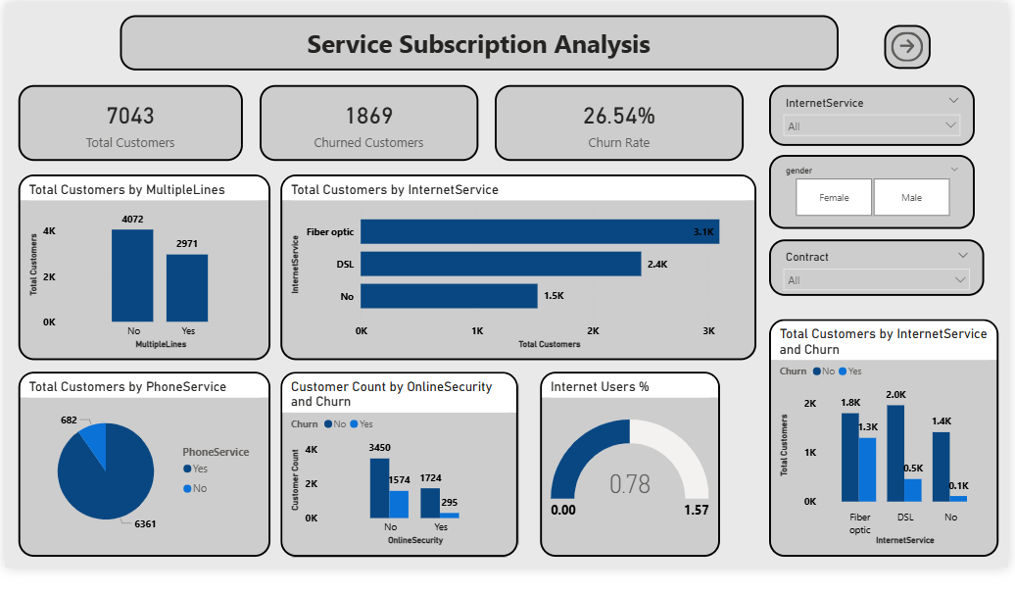

Slide 9
Key Questions Answered
Distribution of customers across different internet services
Customers churned by internet service type?
How does churn vary between customers with and without online security?
Adoption rate of phone service among customers
Usage of multiple phone lines by Customers
Key Insights
Fiber optic is the most widely used internet service among customers.
Fiber optic customers exhibit the highest churn compared to DSL and non-internet users.
Customers without online security show significantly higher churn rates.

Slide 10
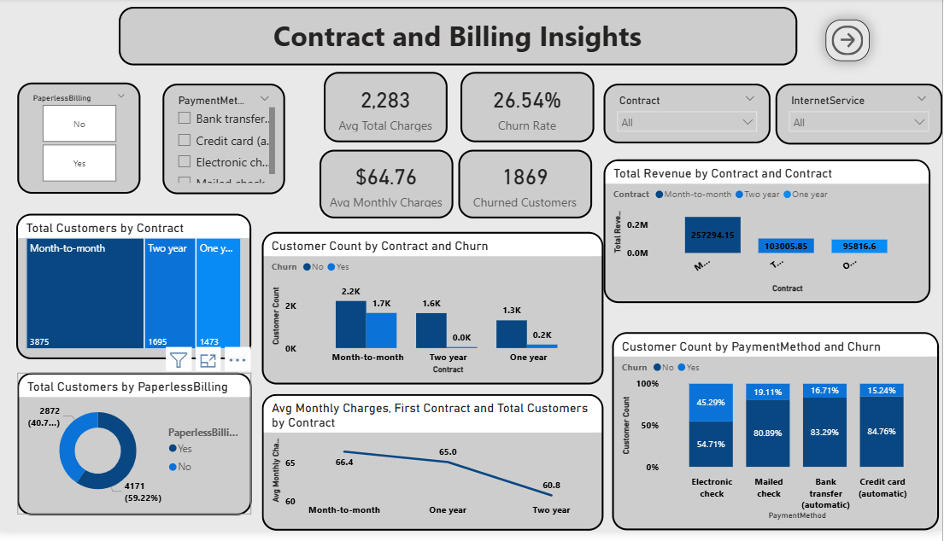

Slide 11
Key Questions Answered
What is the distribution of customers across different contract types?
How does churn vary by contract type?
What are the average monthly charges for each contract type?
Which payment methods are most commonly used?
How does churn differ across payment methods?
Customers distribution by billing type (paperless vs non-paperless)?
Key Insights
Month-to-month contracts have the highest number of customers.
Month-to-month customers experience significantly higher churn than long-term contracts.
One-year and two-year contracts show better customer retention.
Electronic check payment method shows the highest churn rate.
Long-term contracts contribute to more stable revenue and lower churn.

Slide 12
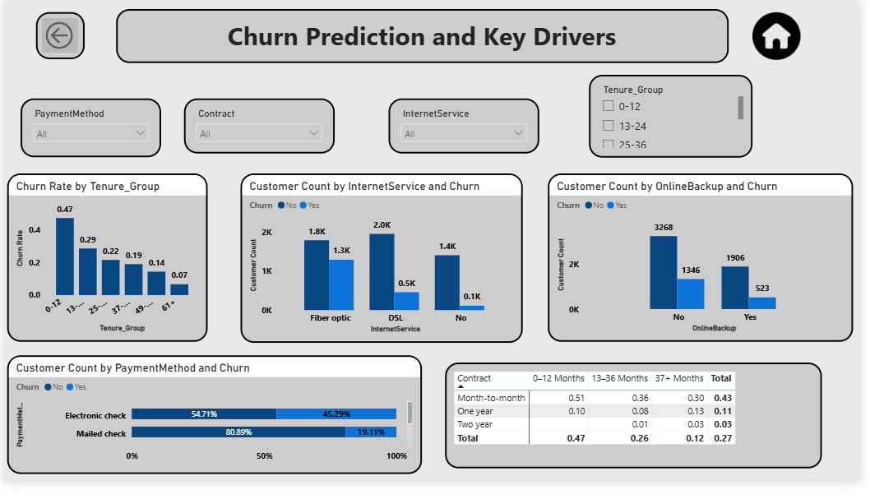

Slide 13
Key Questions Answered
Which customer segments are at the highest risk of churn?
How does churn vary across tenure groups?
What is the impact of contract type on churn risk?
How do payment methods influence churn behavior?
Do add-on services reduce churn?
Which combinations of tenure and contract create the highest churn risk?
Key Insights
Short-tenure customers (0–12 months) have the highest churn risk.
Month-to-month contracts are the most churn-prone.
Electronic check users churn more than other payment types.
Fiber optic customers show higher churn than DSL or no-internet users.
Customers without add-on services churn significantly more.
Long-tenure customers on long-term contracts are the most stable.

Slide 14
Strategic Insights & Business Impact
Key Insights & Business Impact
High-Risk Segments
Month-to-month contract customers
Fiber optic internet users
Electronic check payment users
Customer Behavior Patterns
New customers are most vulnerable to churn
Higher monthly charges are linked with higher churn
Long-tenure customers show stronger retention

Slide 15
Recommendations :
1. Improve Retention for New Customers
  Offer onboarding discounts, better support during initial months.
2. Reduce Churn in High-Risk Billing Groups
  Encourage transition from Electronic check → AutoPay.
3. Targeted Offers for Fiber Optic Users
  Provide loyalty discounts, bundled plans.
4. Introduce Contract-Length Incentives
  Convert month-to-month customers into yearly contracts.
5. Prioritize Senior Citizen Customer Support
  Dedicated support line, simplified billing, personalized plans

Slide 16
Conclusion :
The Power BI Customer Churn Analysis reveals clear behavioral, demographic, and billing-related churn drivers.
By leveraging these insights, the company can implement strategies that significantly reduce churn, retain high-value customers, and improve long-term revenue.
This project demonstrates how data-driven decisions can transform customer retention strategy.

Slide 17


